Slide 1
INTRODUCTION
It is a Healthcare Assistant chatbot —an intelligent virtual assistant designed to provide support and information related to health and wellness through natural language conversations.
Leveraging artificial intelligence (AI) and natural language processing (NLP) technologies, I aim to enhance the accessibility and efficiency of healthcare services by offering you a user-friendly interface for seeking medical information, advice, or assistance
Develop a Next.js application that highlights the key features of Next.js along with a comprehensive CRUD AI Prompt sharing system utilizing a MongoDB database and implementing NextAuth authentication and used LLM Model Mixtral 8x7B for the functionality of the chatbot website

Slide 2
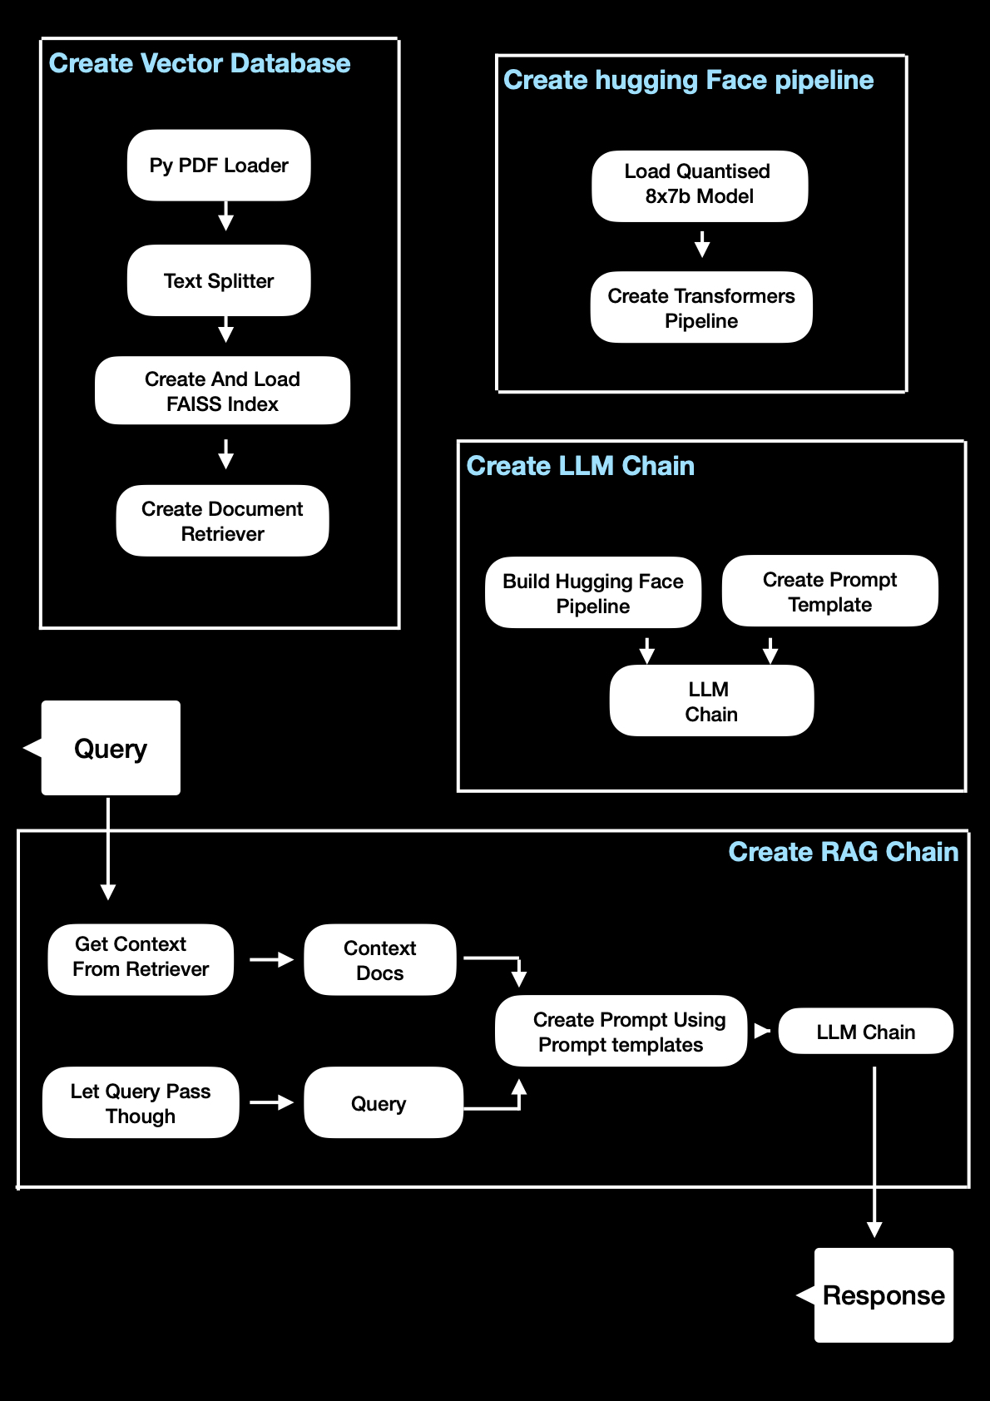
Flowchart

Slide 3
Future improvements
Enable chatbots to securely access and update electronic health records, providing personalized and up-to-date information about the user's medical history.
Improve the chatbot's emotional intelligence to better understand and respond to the emotional needs of users. This could be especially valuable in mental health applications.
Evolve chatbots into comprehensive virtual health assistants that not only provide medical information but also assist with medication reminders, appointment scheduling, and lifestyle recommendations.
Team Members:
- Toshan Gupta
- Garv Gupta
- Smit Shah
- Tushar Mittal

